Slide 1
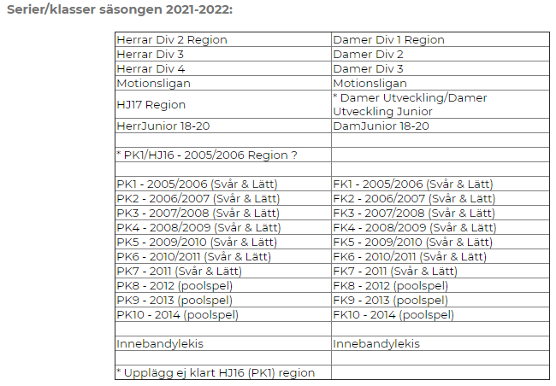
Serieanmälan Dam/Flick
D1 D1
DJ DJ 18-20
FK1
FK2 F06/07L
FK3 F06-09L?
FK4 F08/09L
FK5
FK6
FK7 F10-11L
FK8 F12
FK9 F13-14
FK10
Innebandylekis F14-15

Slide 2
Serieanmälan Herr/Pojk
H2 H2
HJ HJ?
HJ16
PK1
PK2 P07
PK3 P07
PK4 P09/P08
PK5 P10L
PK6 P10-11S
PK7 P11S
PK8 P12
PK9 P13
PK10 P14
Innebandylekis

